Slide 1
Certification of Avionics Embedded Systems
In collaboration with Marinvent Corporation
Chapter 4.1
SAE ARP4754 and 4761 Safety Assessments Part 1
presented by:
John Maris
john@marinvent.com

Slide 2

Caution
    This module is designed to show the application of the certification principles contained in the others chapters. As such, it touches upon many aspects of the certification process, but the material is not complete, comprehensive, or necessarily current with the latest regulations and guidance materials. For these reasons, the analysis contained in the following slides should not be used as the basis of a certification program for the system under investigation.

Slide 3
Summary
    4.1 SAE ARP 4754 and 4761 Safety Assessments
      4.1.1 ARP4761 Severity vs. Probabilities
      4.1.2 Failure Condition Classification Review
      4.1.3 Probability Definition Reviews
      4.1.4 The Development Life Cycle
      4.1.5 The Safety Assessment Processes
      4.1.6 ARP4754A Development Program
      4.1.7 Aircraft System, and Detailed Design Elements
      4.1.8 Integral processes
      4.1.9 Safety Document Relationships
      4.1.10 Safety Objectives Verification Approach Overview
      4.1.11 Functional Hazard Assessment
      4.1.12 An Unsucessful FHA
      4.1.13 Preliminary System Safety Assessment
      4.1.14 Pssa Output Example
      4.1.15 System safety Assessment (SSA)

Slide 4
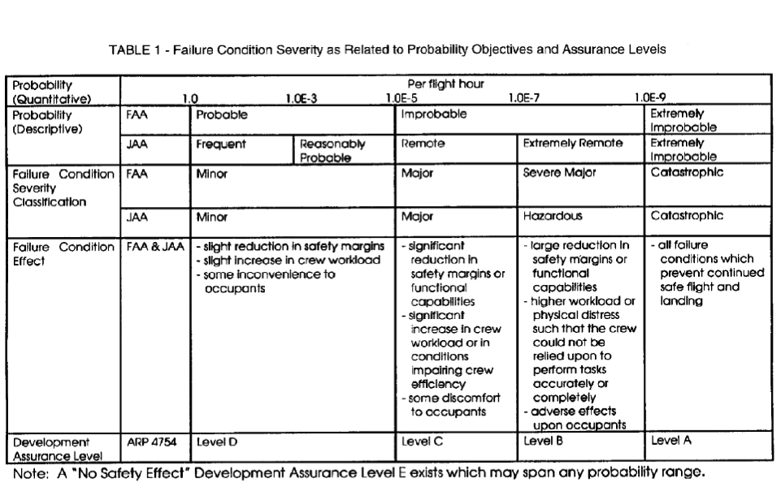
4.1.1 ARP4761 Severity vs. Probabilities
Figure 4.1.1 – Failure Conditions Severity as Related to probability Objectives and Assurance Levels

Slide 5
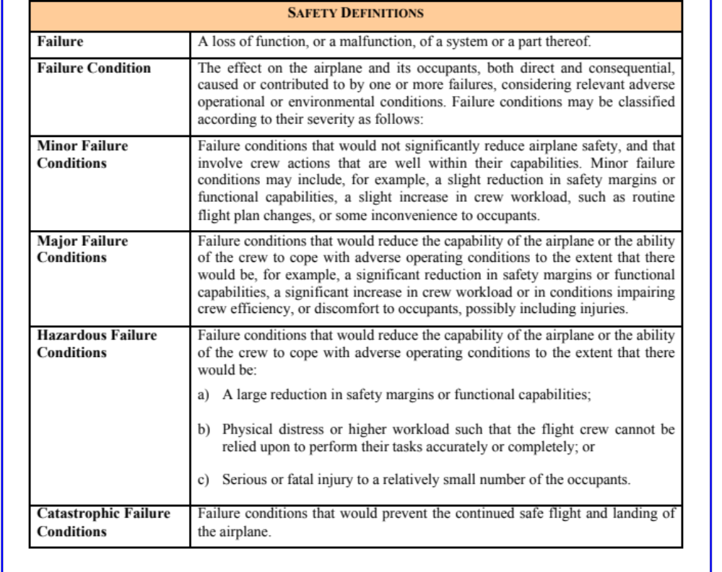
4.1.2 Failure Condition Classification Review
Figure 4.1.2 –

Slide 6
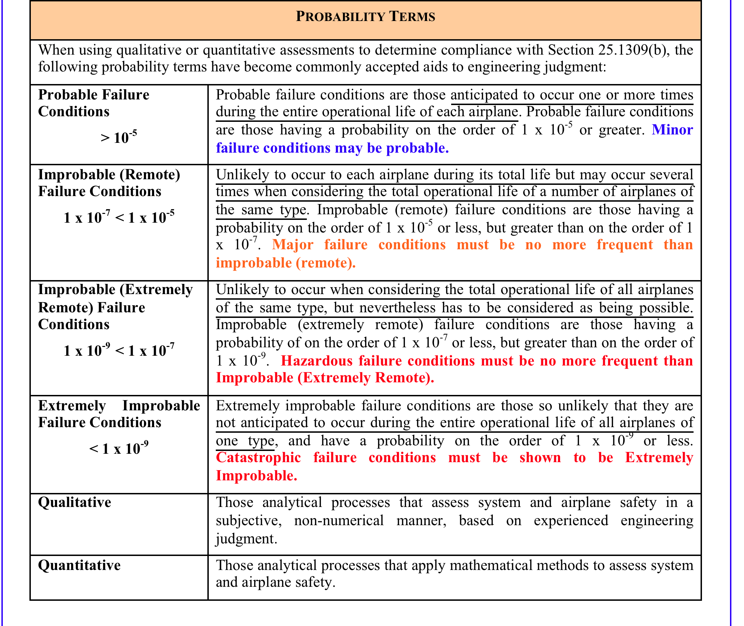
4.1.3 Probability Definition Review
Figure 4.1.3 –

Slide 7
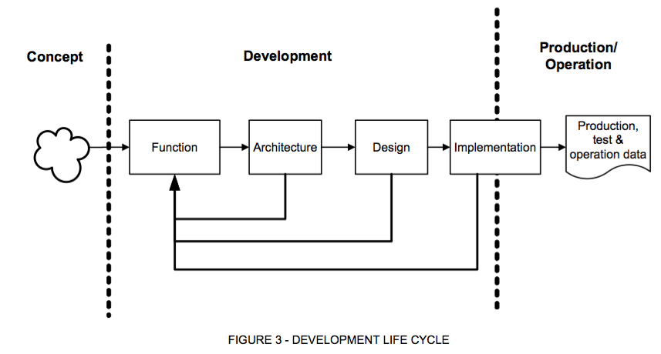
4.3.4 The Development Life Cycle
(SAE ARP4761)
Figure 4.1.4 – Development Life Cycle

Slide 8
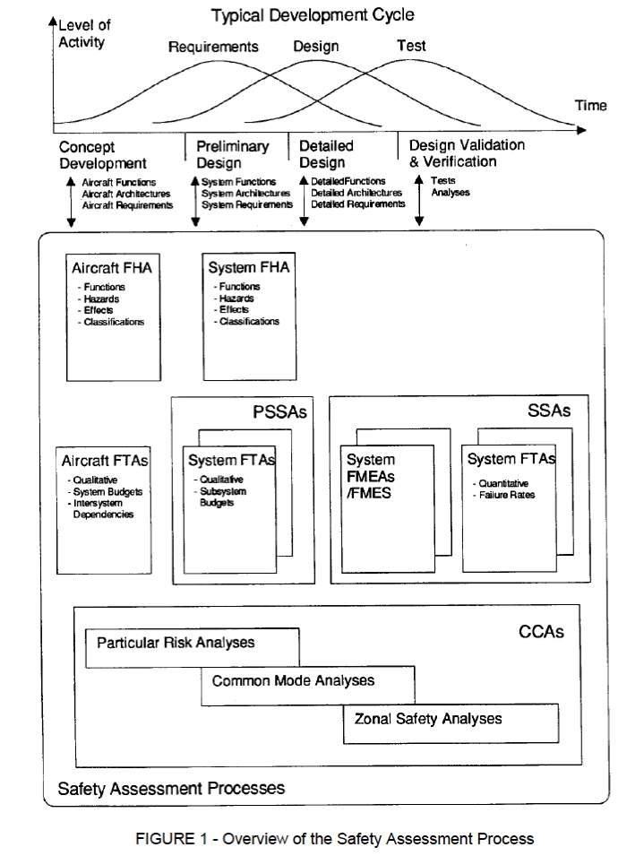
4.3.5 The Safety Assessment Processes (SAE ARP 4761)
Figure 4.1.5 – Overview of the Safety Assessment Process

Slide 9
4.3.5 Safety Assessment Processes (cont’d)
The previous figure introduces two important concepts:
  The distinction between Aircraft, System, & Detailed functions, architectures and requirements.
  A large number of Safety Assessment Processes.
This lecture addresses Functional Hazard Assessments (FHA) and top-level System Safety Assessment processes.
The second lecture introduces some of the safety assessment techniques, such as FMEAs, FMES, FTAs, and CCAs.

Slide 10
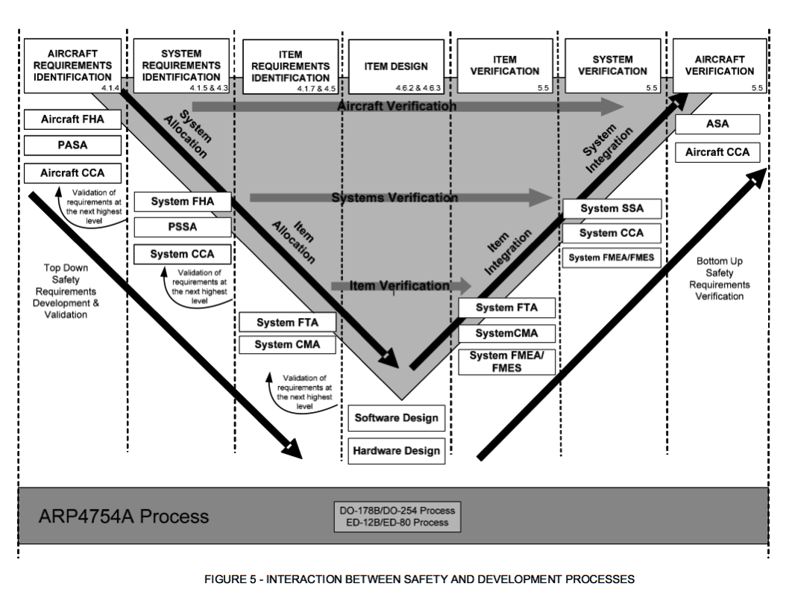
4.3.6 ARP4754A Development Process
Figure 4.1.6 – Interaction between Safety and Development Processes

Slide 11
4.3.7 Aircraft, System, and Detailed Design Elements
Although the definition of an aircraft seems fairly clear, this is not the case with Aircraft Systems and Detailed Design elements.
  For example, to an aircraft Original Equipment Manufacturer (OEM), an engine is a System, and the engine’s components, such as a fuel control unit (“FCU’”), are Detailed Design elements.
  To an engine manufacturer, the engine is the top “aircraft level” element; the FCU is a System, and the FCU components are Detailed Design elements.
  To an FCU manufacturer, the top-level element is the FCU, while the FCU fuel pump is a System, and the fuel pump components are Detailed Design elements.
  To a fuel pump manufacturer…
  All of the analyses described in this chapter flow up and down the entire chain described above.

Slide 12
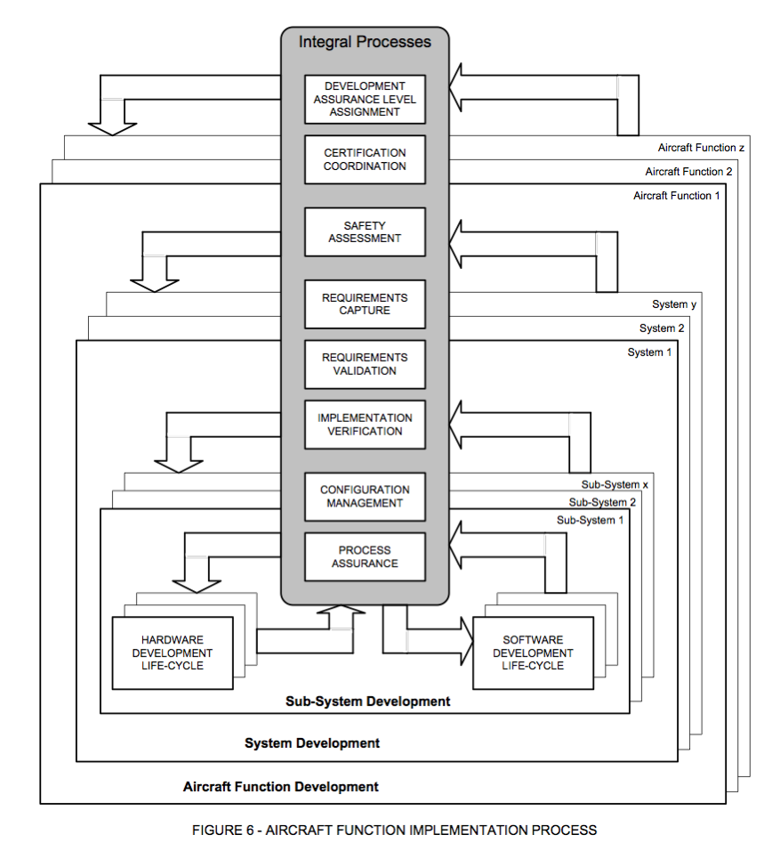
4.3.8 Integral Processes (SAE ARP 4754A)
Figure 4.1.7 – Aircraft function implementation process

Slide 13
4.3.8 Integral Processes (cont’d)
Part 1 of this lecture addresses the following Safety Assessment Integral Processes:
  Functional Hazard Assessments (FHA)
  Preliminary Aircraft / System Safety Assessment (PSSA)
  Aircraft / System Safety Assessment (SSA)
These processes are defined in a number of interrelated documents as shown in the following slide

Slide 14
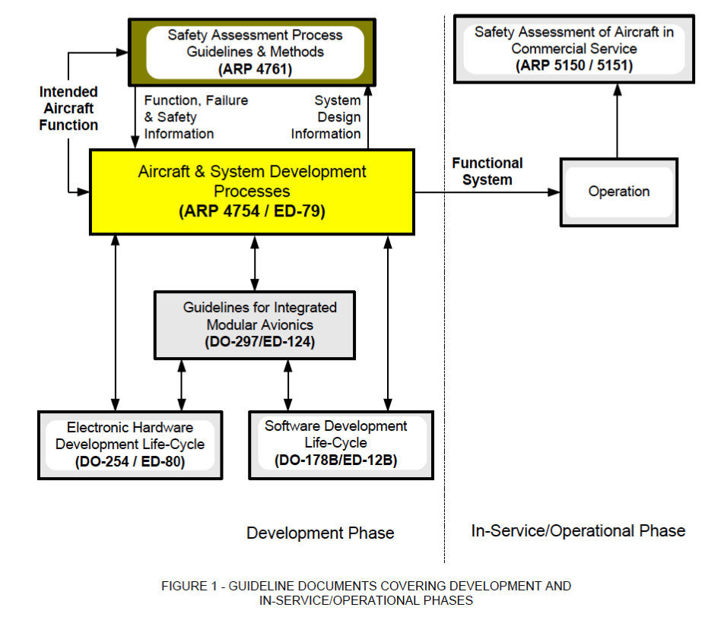
4.3.9 Safety Document Relationships (SAE ARP 4754A)
Figure 4.1.8 – Guideline documents covering development and in-service/operational phases

Slide 15
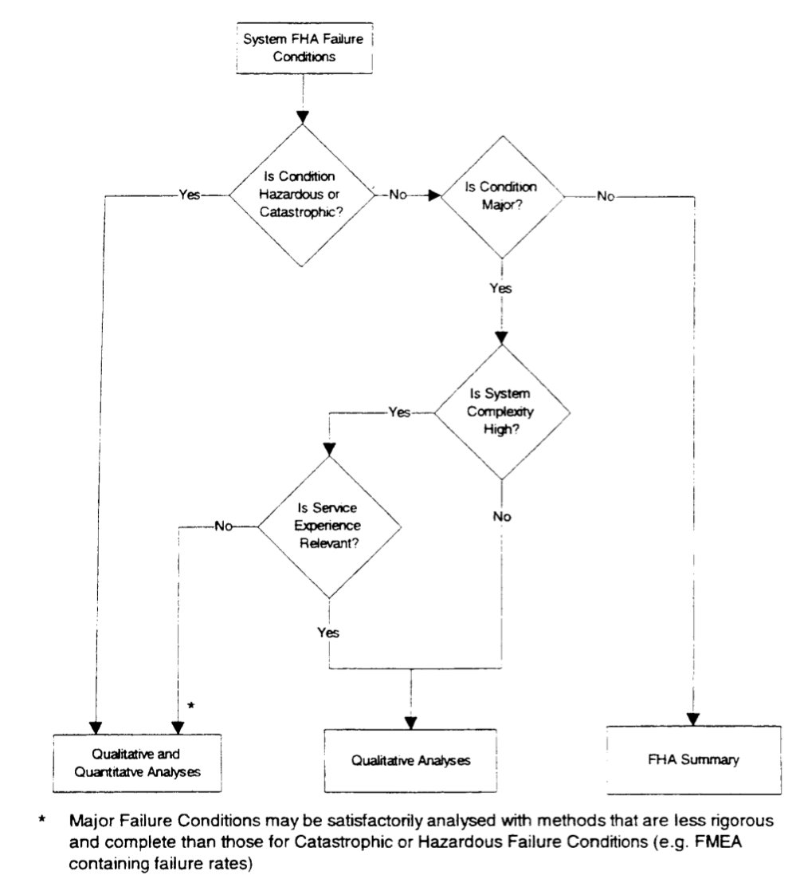
4.3.10 Safety Objective Verification Approach Overview
Figure 4.1.9 –

Slide 16
4.3.11 Functional Hazard Assessment (FHA)
The FHA is an Iterative Process that is conducted at the Aircraft and System levels that:
  Identifies related Failure Conditions
  Identifies effects of Failure Conditions
  Classifies each Failure Condition, based on the identified effects, as: Catastrophic, Hazardous/Severe-Major, Major, Minor, or No Safety Effect
  Assigns necessary safety objectives, per AC 25.1309-1A, AC23.1309-1D and AMC 25.1309, etc.
  States the assumptions for each Failure Condition (e.g., adverse operational or environmental conditions and phase of flight).

Slide 17
4.3.11 Functional Hazard Assessment (FHA) (cont’d)
From SAE-ARP 4754A Identifies related Failure Conditions
  Implementation choices made during development may introduce common causes for multiple aircraft-level Failure Conditions or interactions between systems resulting in failure
  These common causes could cross system or function boundaries
  A review of the implementations of systems should be performed to determine if there are such conditions and if they should be added to the aircraft-level FHA

Slide 18
4.3.11 Functional Hazard Assessment (FHA) (cont’d)
FHA Case Study: American Airlines DC-10 crash on takeoff from Chicago O’Hare Identifies related Failure Conditions
  Maintenance damage caused left engine separation on takeoff
  Electrical and hydraulic services from left engine irretrievably lost
  This led to slats retracting on left wing only (no slat locks on this aircraft type)
  Slat position indicator failed due to loss of electrical bus
  Stall warning computer disabled from loss of electrical power to computer + loss of slat position information
  Aircrew reduced speed, as trained, to engine-out safety speed
  Left wing stalled, without any warning to crew

Slide 19
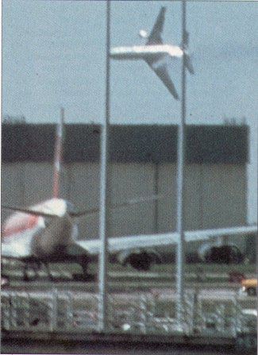
4.3.12 An Unsuccessful FHA
Figure 4.1.10 – Aircraft crashing on takeoff

Slide 20
4.3.13 Preliminary System Safety Assessment (PSSA)
From SAE- ARP 4754A, the PSSA:
  Is a systematic examination of a proposed architecture(s) to determine how failures could cause the Failure Conditions identified by the FHA
  Validates that proposed architecture can reasonably be expected to meet the safety requirements
  The PASA/PSSA may identify the need for alternative protective strategies (e.g., partitioning, built-in-test, monitoring, independence and safety maintenance task intervals, etc.)
  PSSA outputs are input to the SSA and other documents, including, but not limited to, system requirements, software requirements, and hardware requirements

Slide 21
4.3.13 Preliminary System Safety Assessment (PSSA) (cont’d)
From SAE- ARP 4754A, the PSSA:
  The PSSA is an iterative process associated with the design definition
  It is conducted at multiple stages of system development including aircraft, system, and item design definitions
  At the lowest level, the PSSA determines the safety related design requirements of hardware and software

Slide 22
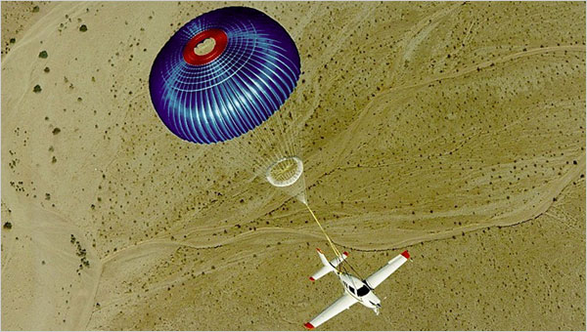
4.3.14 PSSA Output Example
Figure 4.1.11 – PSSA outcome example: the ballistic parachute employed
in the Cirrus series of light aircraft

Slide 23
4.3.15 System Safety Assessment (SSA) (SAE ARP 4754A)
An Aircraft/System Safety Assessment (ASA/SSA) is a systematic, comprehensive evaluation of the implemented aircraft and system(s) to show that relevant safety requirements are satisfied
The difference between the PASA/PSSA and an ASA/SSA is that the PASA/PSSA are methods to evaluate proposed architectures and derive system/item safety requirements; whereas the ASA/SSA are methods to verify that the implemented design meets the safety requirements as defined in the PASA and PSSA

Slide 24
4.3.15 System Safety Assessment (SSA) (SAE ARP 4754A) (cont’d)
The ASA/SSA integrates the results of the various analyses to verify the safety of the overall aircraft/systems and to cover all of the specific safety considerations identified in the PASA/PSSA. The ASA/SSA process data includes results of the relevant analyses and substantiation

Slide 25
4.3.15 System Safety Assessment (SSA) (SAE ARP 4754A) (cont’d)
The ASA/SSA may include the following information
  List of previously agreed upon external event probabilities
  System description including functions and interfaces
  List of Failure Conditions (FHA, PASA, PSSA)
  Failure Condition classification (FHA, PASA, PSSA)
  Qualitative analyses for Failure Conditions (e.g. FTA, FMES, Markov Analysis, Dependence Diagrams)
  Quantitative analyses for Failure Conditions (e.g. FTA, FMES, Markov Analysis, Dependence Diagrams)
  The results obtained from Common Cause Analyses
  Safety related tasks and intervals (FTA, FMES, Markov Analysis, Dependence Diagrams)

Slide 26
4.3.15 System Safety Assessment (SSA) (SAE ARP 4754A) (cont’d)
The ASA/SSA may include the following information
  Development Assurance Levels for aircraft functions and systems (FDAL) (PASA, PSSA)
  Development Assurance Levels for electronic hardware and software items (IDAL)(PSSA)
  Verification that safety requirements from the PASA, PSSA are incorporated into the design and/or testing process
  The results of the non-analytic verification processes (i.e. test, demonstration and inspection)

Slide 27
4.3.15 System Safety Assessment (SSA) (SAE ARP 4754A) (cont’d)
The ASA should provide a summary of the aircraft safety activities from the beginning of the concept development to the completion of the detailed design development
It aims to show compliance with aircraft level requirements and objectives and give assurance that the appropriate methods and process have been applied. The Aircraft Safety Assessment verifies that
  All the safety activities have been performed according to the Safety Plan.
  Safety requirements for the aircraft are satisfied and associated supporting material is available.
  The Safety Validation/Verification process is completed and results accepted,
  All the activities undertaken form a logical argument supporting the conclusion that the aircraft is safe.

Slide 28
4.3.15 System Safety Assessment (SSA) (SAE ARP 4754A) (cont’d)
This ASA is part of the “safety case” or “safety synthesis” which communicates a clear, comprehensible and defensible argument that the aircraft and systems are acceptably safe to operate in a particular context

Slide 29
Summary
This lecture has outlined the system development life-cycle and introduced several key safety concepts:
  Failure and Failure Conditions
  Integral Processes
  Functional Hazard Assessments
  Preliminary System Safety Assessments and Aircraft System Safety Assessments
The second part of the lecture examines several system safety assessment techniques, such as FMEAs, FMES, FTAs, and CCAs.

Slide 30

Questions?

Slide 31
References
SAE Aerospace Recommended Practice ARP4754A Guidelines for Development of Civil Aircraft and Systems, Rev A, 2010/12
SAE Aerospace Recommended Practice ARP4761 Guidelines and Methods for Conducting the Safety Assessment Process on Civil Airborne Systems and Equipment, Rev A, 1996/12

Slide 32
Image References
Figure 4.1.1 to 4.1.5: SAE ARP4761
Figure 4.1.6 to 4.1.8: SAE ARP4754
Figure 4.1.9: SAE ARP4761
Figure 4.1.10: http://www.airdisaster.com/photos/aa191/photo.shtml
Figure 4.1.11: http://www.nytimes.com/2006/10/15/weekinreview/15basic.html

